Slide 1
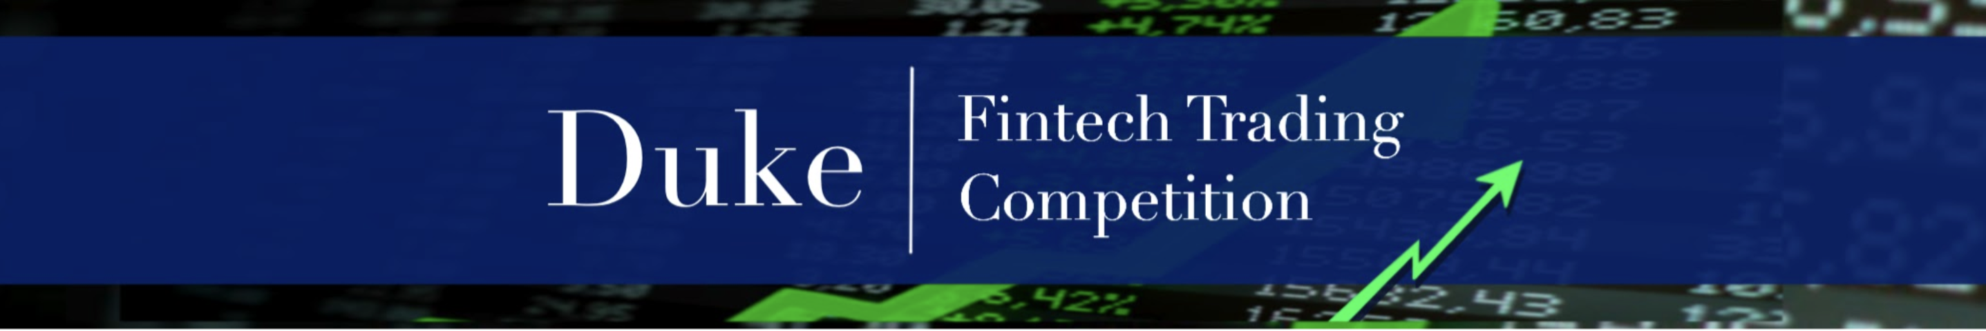
Creating your IBKR Paper Trader

Slide 2
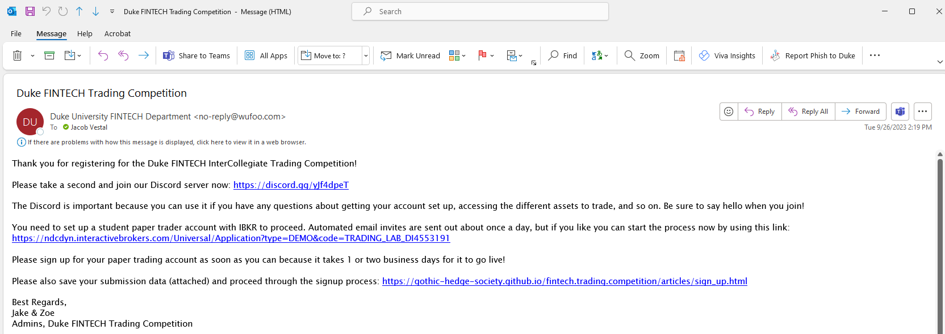

Slide 3
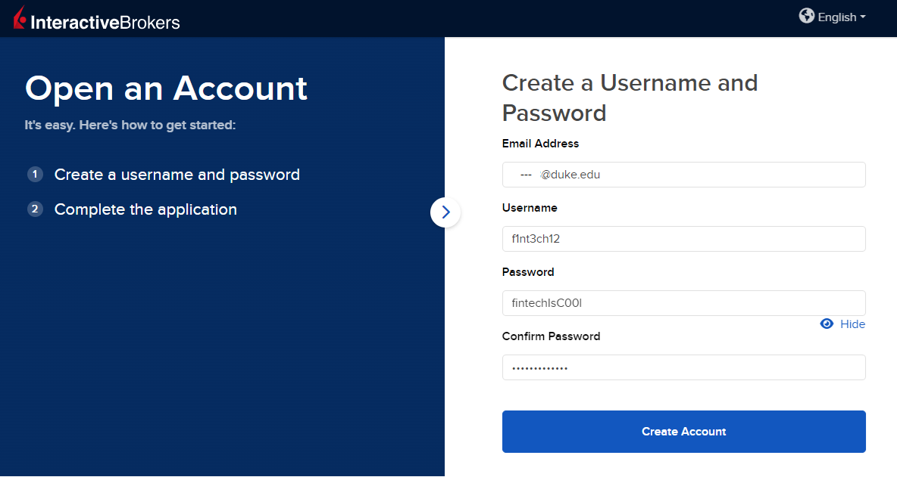

Slide 4
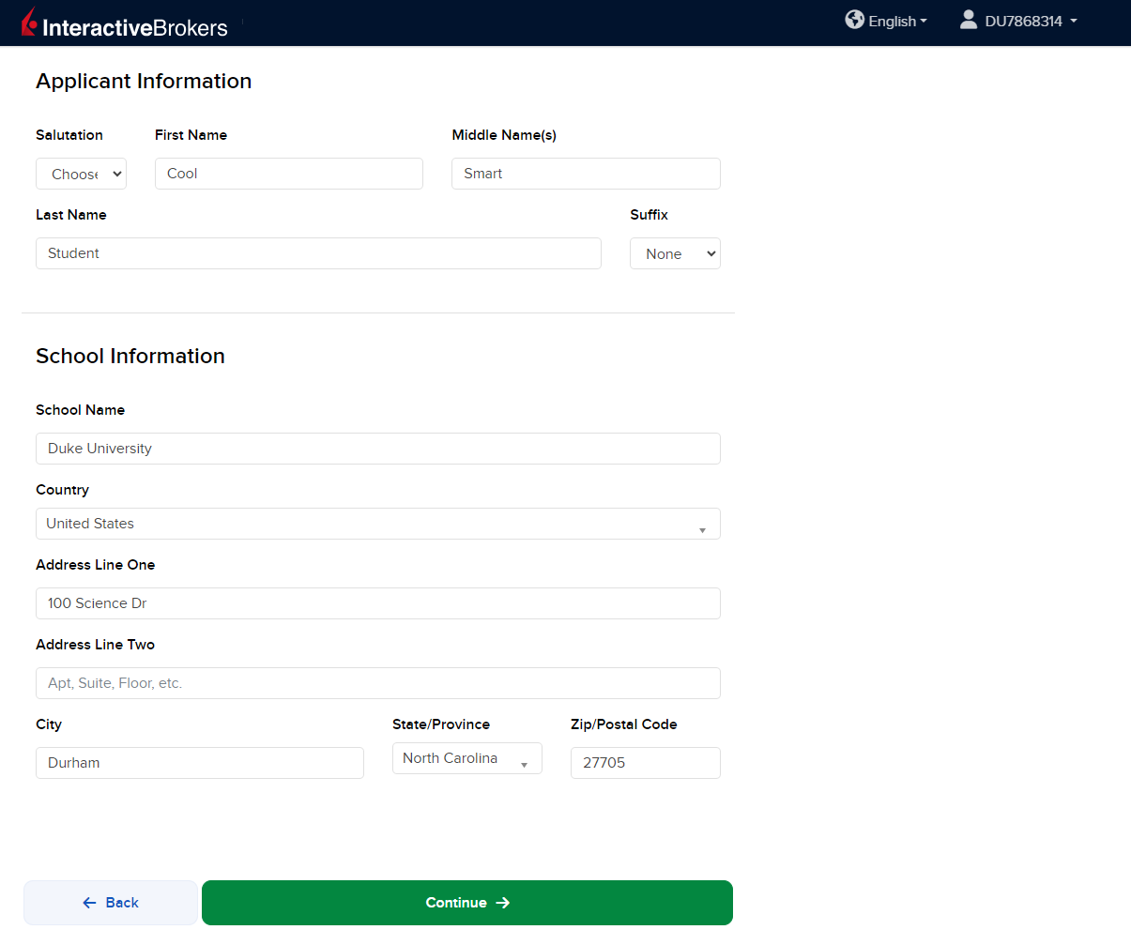

Slide 5
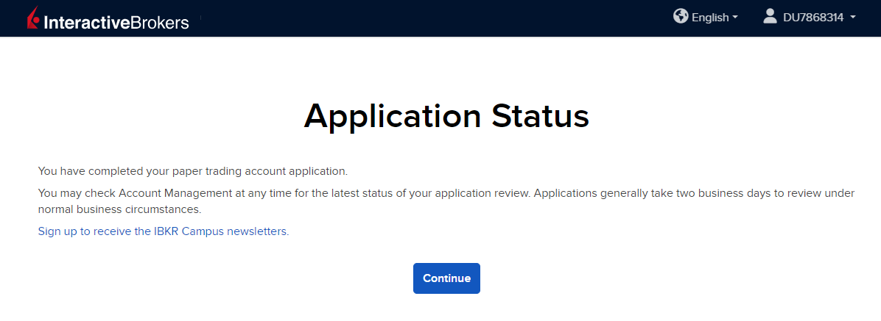

Slide 6
Remember:
Be sure you use the link in your confirmation email to set up your account
This competition is free and for students
You do NOT need to enter any banking or funding info
You do NOT need to answer any more questions than what you saw in this video
→ Post on the Discord with any questions!

